Slide 1
ANALYSIS OF CUSTOMER REVIEW DATA ON BA:
PRELIMINARY ANALYSIS USING WORDCLOUD AND TOPIC MODELLING

Slide 2
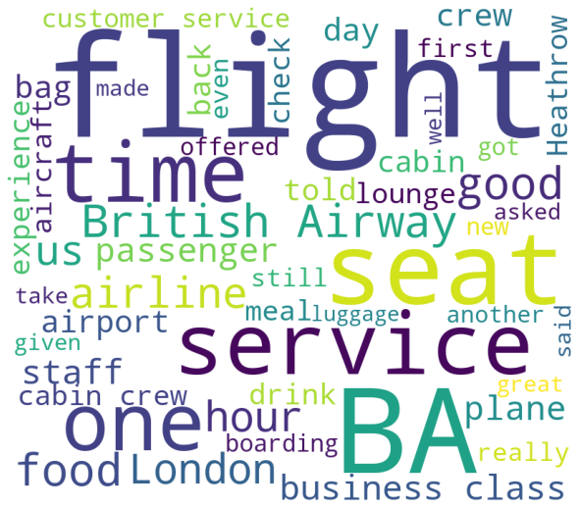
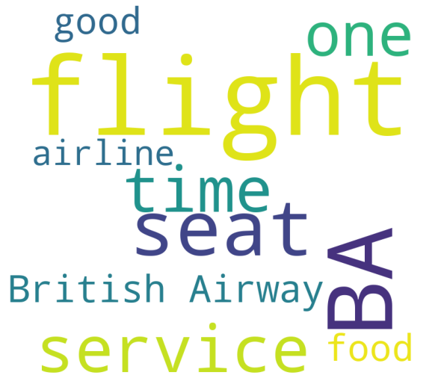
SUMMARY
Reviewers generally appear to have been positive of services and crew, neutral to airhostesses and critical with other customers especially mothers.
From the word cloud, it seems there was a lot of reviews about Heathrow airport.
Most reviews were about the business class.
Cabin Crew and crew respectively as well as staff/customer service were frequently mentioned apparently for good work.
Most reviews related to the time, flight, seat, food, and service.
'good' is in the top ten most frequent words in reviews indicating widespread satisfaction.

